Slide 1




JavaScript Exception Handling
Throw, Catch and Process Exceptions in JS. Best Practices
SoftUni Team
Technical Trainers
Software University
http://softuni.bg

Slide 2
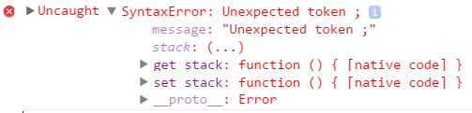
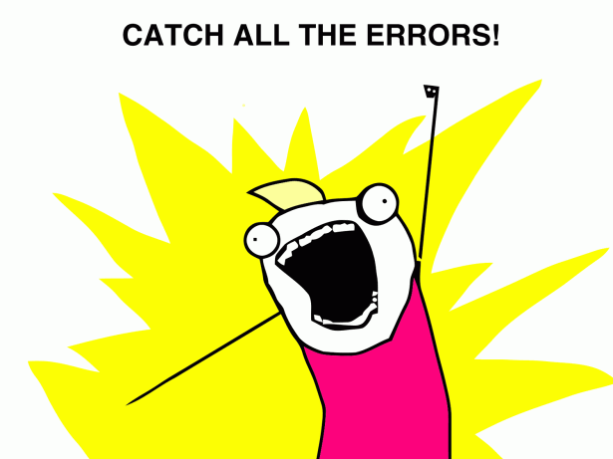
Table of Contents
Exceptions in JavaScript
Throwing Exceptions
Throwing Right Exception
Exception Handling
The classical try-catch block
Custom Exceptions
Throwing Objects
Best Practices

Slide 3
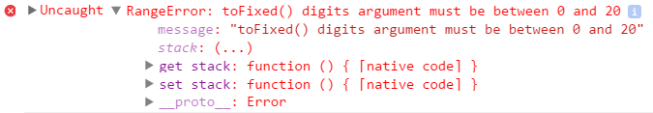
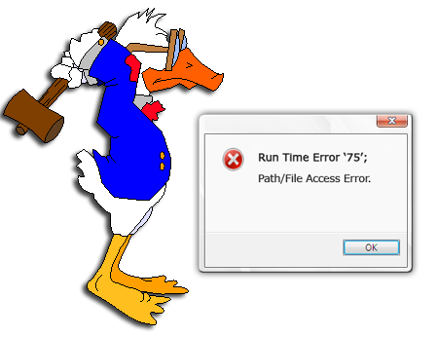

JavaScript Exceptions

Slide 4
JavaScript Exceptions
Exceptions are special objects that hold information about errors / unusual situations
The correct way to handle errors in most programming languages
In JS almost every object / function can throw an exception
JavaScript uses exceptions as primary way to handle errors
Supports the classical throw / try / catch statements
When a problem occurs in JS, an exception is thrown
Some functions return strange neutral value for non-fatal errors
E.g. new Date('hello') → returns 'Invalid date' object
Notes:
In the programming language C “throwing an exception” means to return a value that is defined as an error value for the function (e.g. -1).

Slide 5
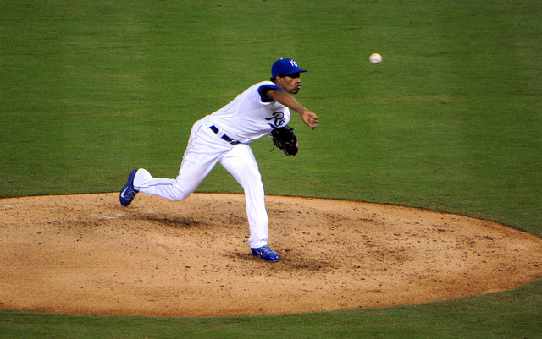

Throwing Exceptions in JS

Slide 6
Throwing Exceptions in JS
The throw statement throws an exception
Execution of the current function will stop
Control will be passed to the first catch block, if there is any
The expression after throw specifies the object to throw
You can throw anything, but prefer Error / object with message
Each of the following throws an exception:
throw "Something is going wrong!";
throw true;
throw 42;

Slide 7
Creating and Throwing Exception
Exceptions can be created using an exception constructor
JavaScript have different constructor for each exception type
The constructor takes an optional message
Throw exception object using the keyword throw
https://developer.mozilla.org/en-US/docs/Web/JavaScript/Reference/Global_Objects/Error
var typeException = new TypeError([message]);
var rangeException = new RangeError([message]);
var referenceException = new ReferenceError([message]);
var typeEx = new TypeError("Incorrect use of an object");
throw typeEx;

Slide 8
Exception Types in JS
Important exception types in JavaScript are:
Error – general error during the execution (base class)
ReferenceError – attempt to access non-existing variable
TypeError – a value is not of the expected type
SyntaxError – trying to execute syntactically invalid JS code
RangeError – a value is not in the range of allowed values
Properties in Error class:
name, message (error description), stack (stack trace)

Slide 9


Throwing Exceptions
Live Demo

Slide 10
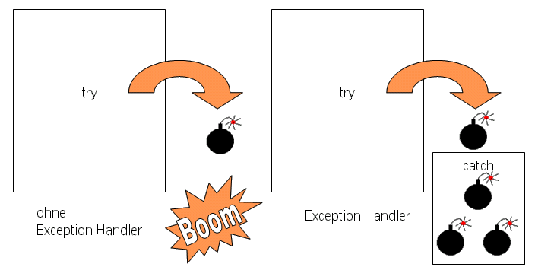
Exception Handling in JavaScript
Catching and Processing Exceptions

Slide 11
Exception Handling
Handling an exception means:
Catch an exception
Using a try-catch block
Resolve the error
E.g. display error message / retry / execute default action
Continue the execution of the application
The execution continues at the first line after the catch block

Slide 12
Exception Handling (2)
Exception handling is done using a try-catch block
If an error occurs inside the try block, the control is passed to the catch section
try {
// code that can throw an exception
} catch (ex) {
// this code is executed in case of exception
// and ex holds the info about the exception
}

Slide 13
Exception Handling (3)
Every try-catch statement can hold only one try and one catch block
To catch a specific exception, check the exception type inside the catch block
No filtering by exception type (like in C#, Java and C++)
The caught object holds information about the exception
Its type (e.g. RangeError)
An exception message (human readable text)

Slide 14
Exceptions and Their Properties – Example
try {
throw new RangeError("Invalid range.");
} catch (ex) {
console.log("---------------");
console.log("Exception object: " + ex);
console.log("Type: " + ex.name);
console.log("Message: " + ex.message);
console.log("---------------");
}
Notes:
Additional properties of the exception object: Microsoft has added a ‘description’ property that is similar to the message property. In Mozilla you can find out in which file the exception has occurred using the ‘filename’ property.

Slide 15
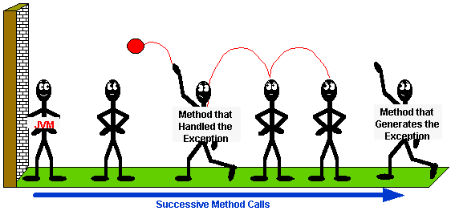
Exceptions and Their Properties
Live Demo

Slide 16


Handling Exceptions by Type
Handle Differently Different Exceptions

Slide 17
Handling Multiple Exception
How can our code handle multiple exceptions?
Perform a check: if-else on the exception type
try {
// Some code causing diferent types of exceptions
} catch (ex) {
if (ex instanceof TypeError) { … }
else if (ex instanceof ReferenceError) { … }
else if (ex instanceof SyntaxError) { … }
}

Slide 18
Handling Exceptions by Type
Live Demo

Slide 19
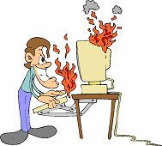
Custom Exceptions
Defining Custom Exception Classes in JS

Slide 20
Custom Exception
Custom exceptions are made by just inheriting the Error class
There is no real benefit from inheriting Error
Most applications don't use custom exceptions
function ArgumentError(message) {
Error.call(message);
}
ArgumentError.inherits(Error);
throw new ArgumentError("The argument is missing");

Slide 21
Custom Exceptions
Live Demo

Slide 22
Custom Exceptions: Why and When?
Inheriting Error is the OOP way
What we gain from this inheritance?
Performance is slower
Constructors are hardly to reuse
Remember: JavaScript is loosely-typed
The only thing a catch wants is an object
It does not care what type of object
Do not use custom exceptions: this is bad practice in JS

Slide 23
More about Custom Exceptions (2)
Any JS object can be thrown as exception
A good practice is to have a "message" property
Throw Error / RangeError / TypeError / ReferenceError or object holding "message" (which is faster)
Don't throw string or other objects
throw { message: "Cannot load comments." };
throw { message: "Age is out of range", minAge: 0, maxAge: 135 };
throw new RangeError("Age should be in range [1...100].");
throw "Error!" // Don't do this!

Slide 24

Throwing Objects
Live Demo

Slide 25


Summary
Exceptions in JS are thrown in case of error
E.g. when invalid data is passed to a function
Stop the script until a catch block is found
JavaScript supports classical try-catch
Throwing exceptions either by:
throw new Error(message)
throw { message: "Error description." }
Don't use custom exceptions
JS OOP

Slide 26







JavaScript Exception Handling
https://softuni.bg/courses/javascript-oop/

Slide 27
License
This course (slides, examples, demos, videos, homework, etc.) is licensed under the "Creative Commons Attribution-NonCommercial-ShareAlike 4.0 International" license
Attribution: this work may contain portions from
"JavaScript OOP" course by Telerik Academy under CC-BY-NC-SA license

Slide 28





Free Trainings @ Software University
Software University Foundation – softuni.org
Software University – High-Quality Education, Profession and Job for Software Developers
softuni.bg
Software University @ Facebook
facebook.com/SoftwareUniversity
Software University @ YouTube
youtube.com/SoftwareUniversity
Software University Forums – forum.softuni.bg

